Slide 1
Microverse Final Capstone
Portfolio Tracker

Slide 2
Inspiration
Used as a journal app for investors / traders, to keep track of their emotion and thought along with their portfolio value.

Slide 3
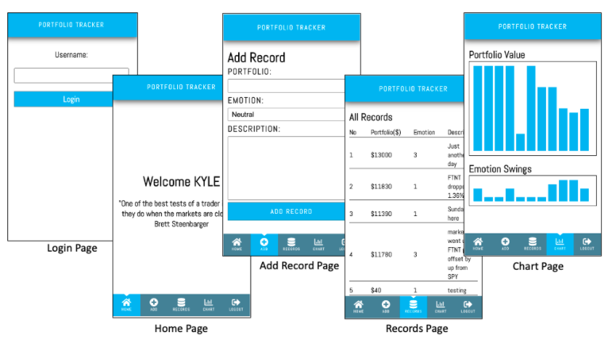
Snapshots

Slide 4
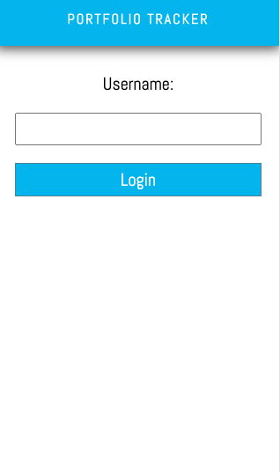
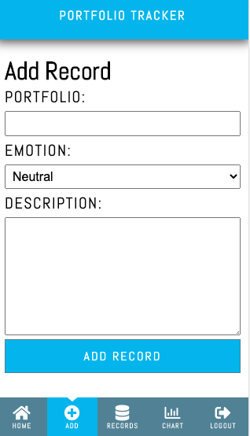
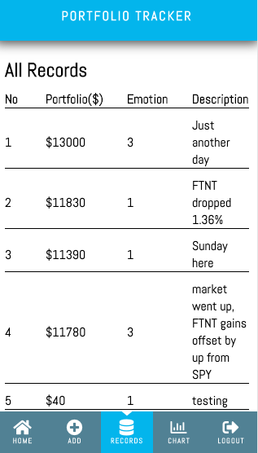
Workflow
The user logs in the app, only by typing the username
The user is presented with a list of things that can be measured: Portfolio, Emotion, Description
The user selects a thing to measure and is presented with a page to introduce the measurement
The user can access a list of things with measurements and check the progress of it within time

Slide 5
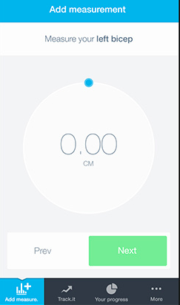
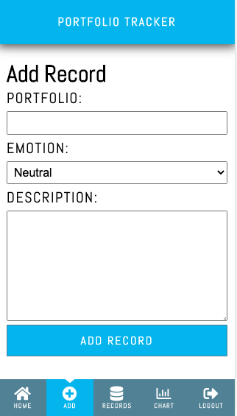

Design
Original
Portfolio Tracker

Slide 6
Nice-To-Have Requirement
Implement proper user authentication from the front-end to the server
Create a user table in your database, so that a given user could only access the measurements they entered
Create an admin panel to create / update / delete things to measure
Make the app responsive, creating both tablet and desktop versions, following design guidelines
You could implement transitions to make user experience better
You can implement the progress page with data charts

Slide 7
Rails API – ERD Diagram

Slide 8
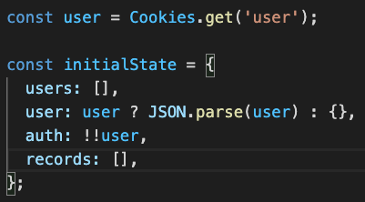
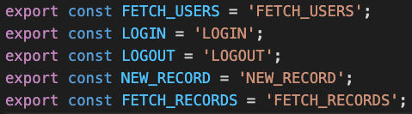
App’s state & actions
User object is stored in browser’s cookie.
!! user return true / false
5 actions, FETCH_USERS run on initial visit, to fetch an array of user objects
Login to set user object

Slide 9
Technical Mandatory
The project is a mobile web app
The database should have at least 2 tables — in this example, things to measure and measurements,
You should use Postgres as your database
For the back-end you will use Ruby on Rails
You will create a REST API to manage database resources, in this case, measurements (things to measure could be added manually to the database or from an admin panel)
For the front-end you will use React
Connects to the back-end API to send and receive domain data
With routes for each of the screens, so the user can easily go back and forward
Using redux to store info used across the app, like the username
The project will be deployed and accessible online

Slide 10
Accessment Criteria
Create structured HTML & CSS code.
Apply front-end best practices.
Ability to create UIs adjusted to given designs.
Implement basic OOP principles (encapsulation, inheritance, abstraction, polymorphism) in Ruby
Design DB schema based on real life example
Use MVP to structure backend code
Implement basic CRUD operations
Implement Active Record associations to model real life system
Implement a RESTful API with proper routes
Apply back-end best practices.
Send and receive data from a back-end endpoint
Implement interactive application respond to user interactions
Design a components structure for a website
Understand data management in front-end components
Manage front-end data using a shared state pattern
Ability to provide, as well as receive, feedback collaboratively and in a constructive manner. Coachable.
Never done learning and always seeking to improve themselves. Curious about new possibilities and acts to explore them.
Ability to perform tasks and complete projects with minimal supervision.
Ability to multitask and effectively manage time and prioritization.
Follow a industry standard workflow with version control system tools.

